Slide 1
Visitor Management Mockups

Slide 2
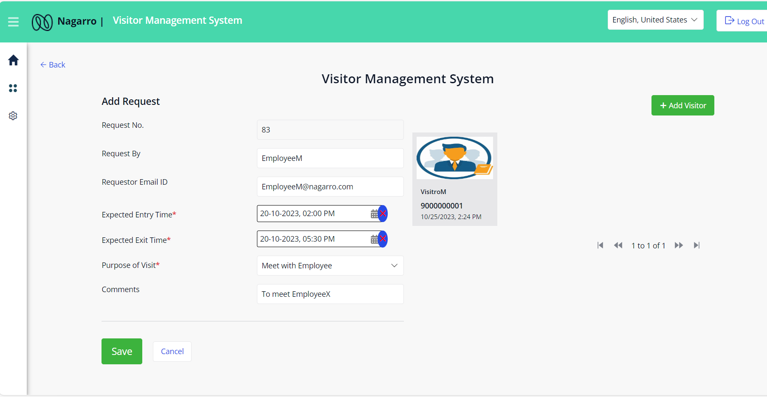
Visitor management system –New Request

Slide 3
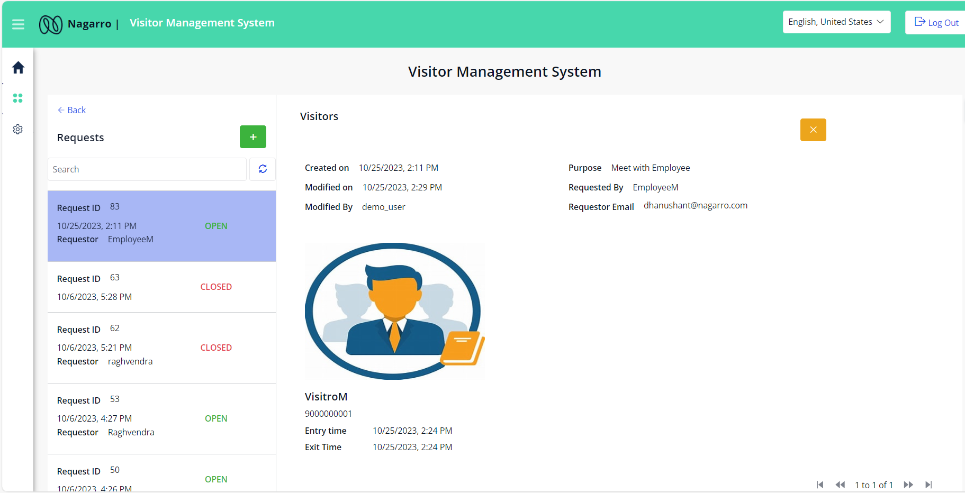
Visitor management system – Request Overview

Slide 4
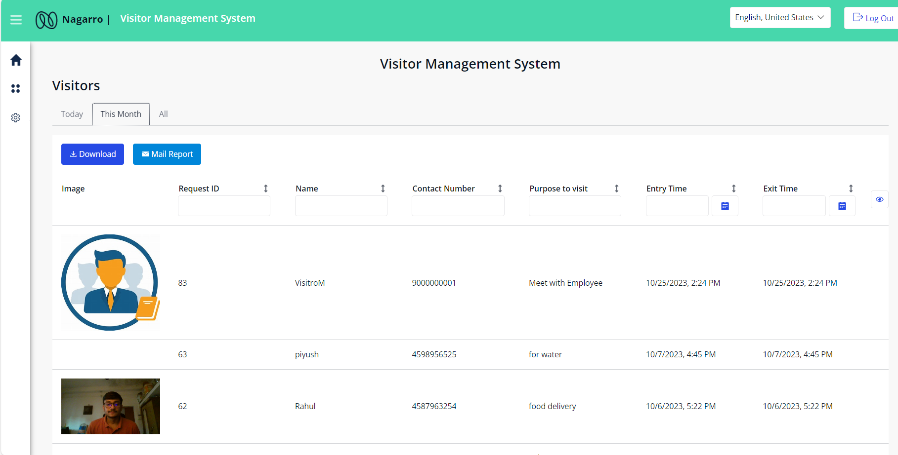

Visitor management system – Visitors Overview

Slide 5
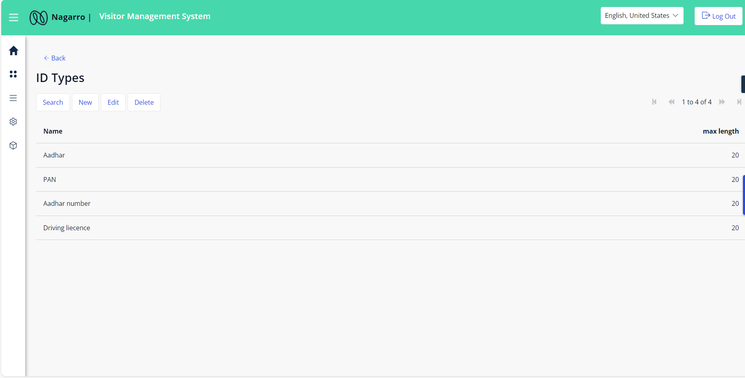
Visitor management system – DocumentType Overview

Slide 6
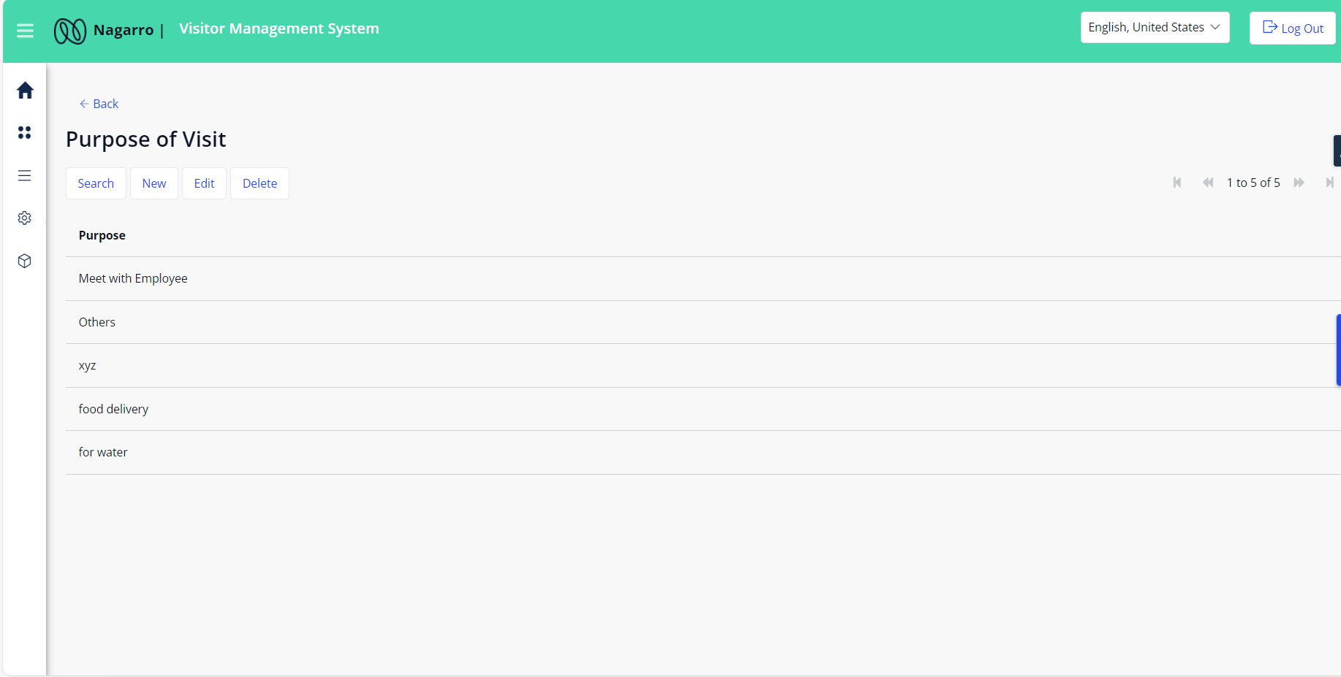
Visitor management system – VisitPurpose Overview

Slide 7
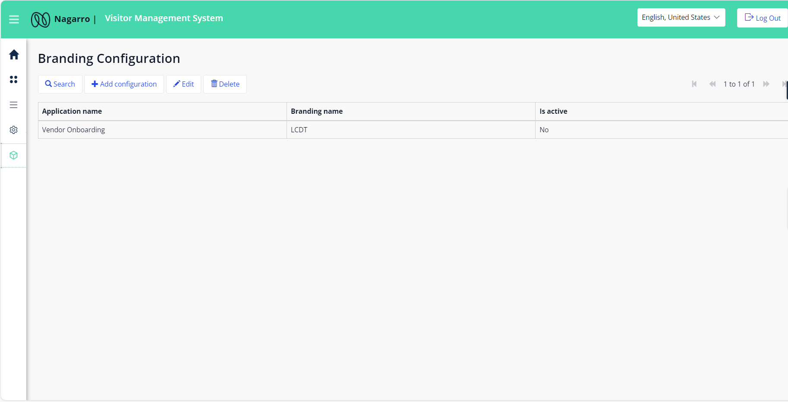
Visitor management system – VisitPurpose Overview

